Slide 1
Phase-7 Prototype Design
Supervised by
Dr. Sabah Mohammad

Slide 2

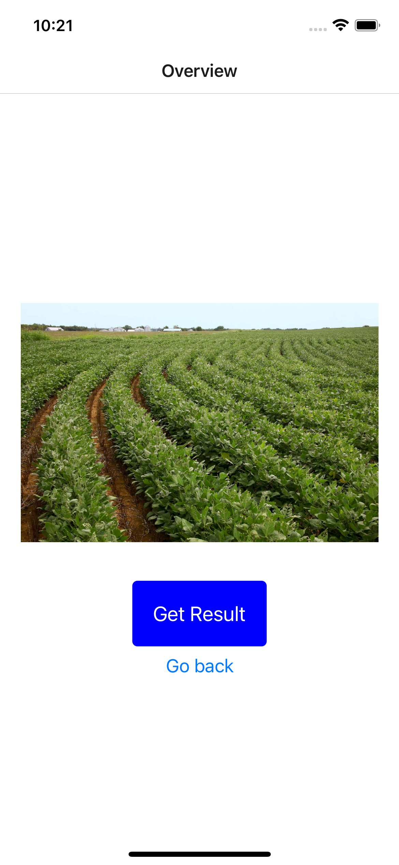
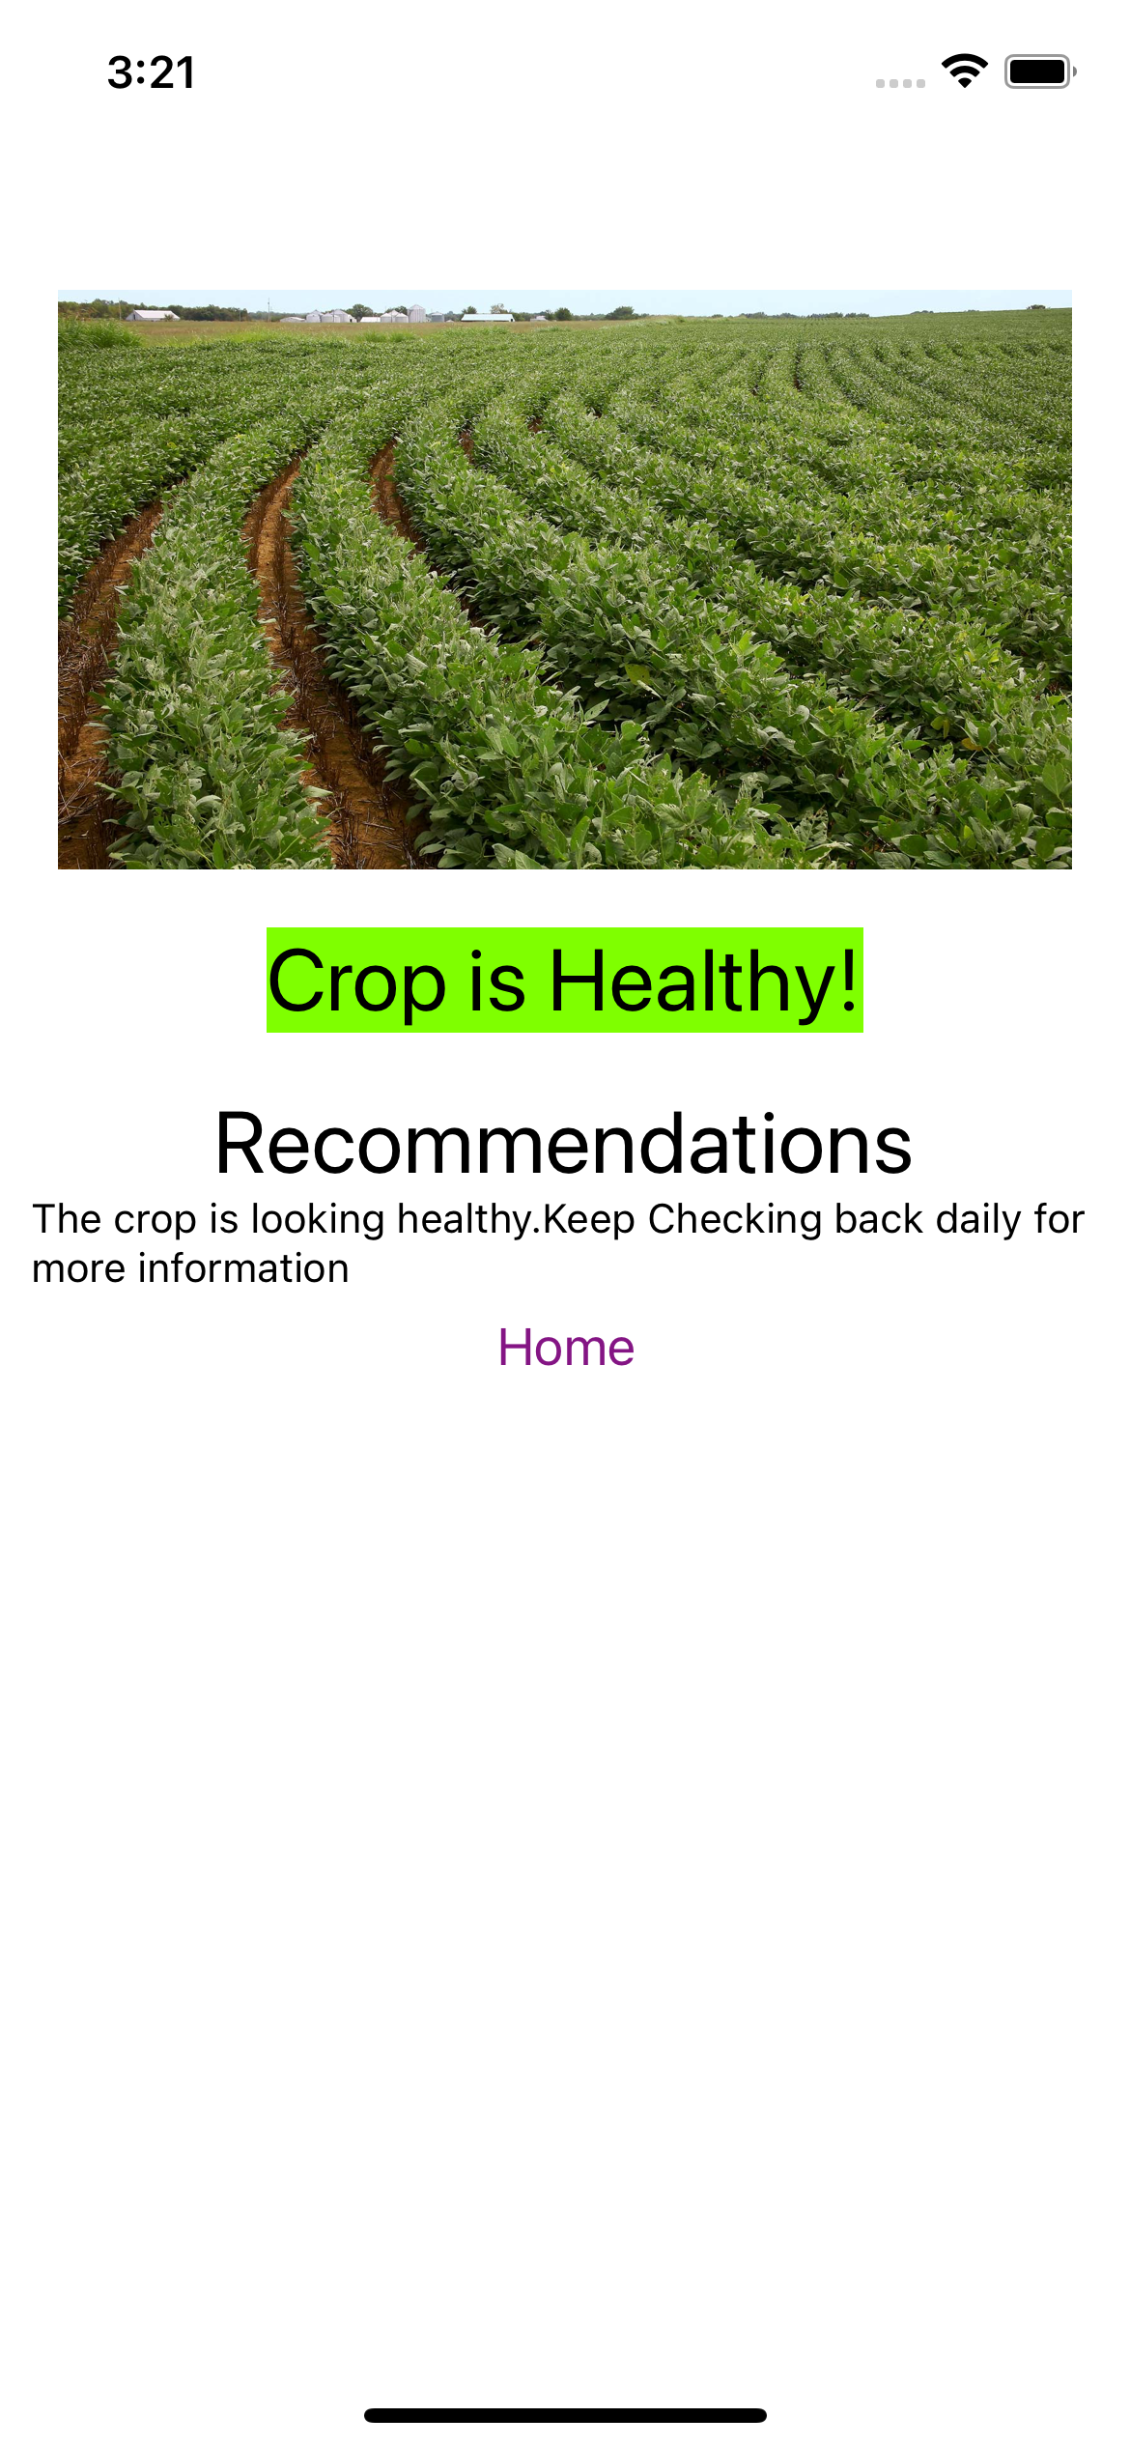
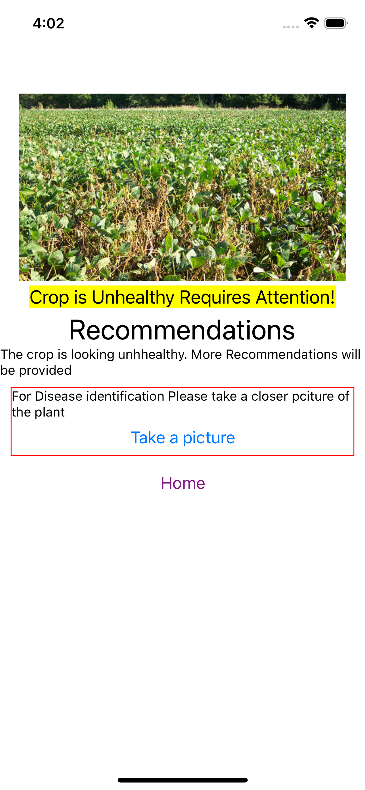
Prototypes:

Slide 3
Other Features:
Start and end date of the crop
Collecting factors affecting the growth of the crops
Image Analysis for Identification of the plant disease.
Recommendations to the users
More accurate results

Slide 4
Thank You!

